Slide 1
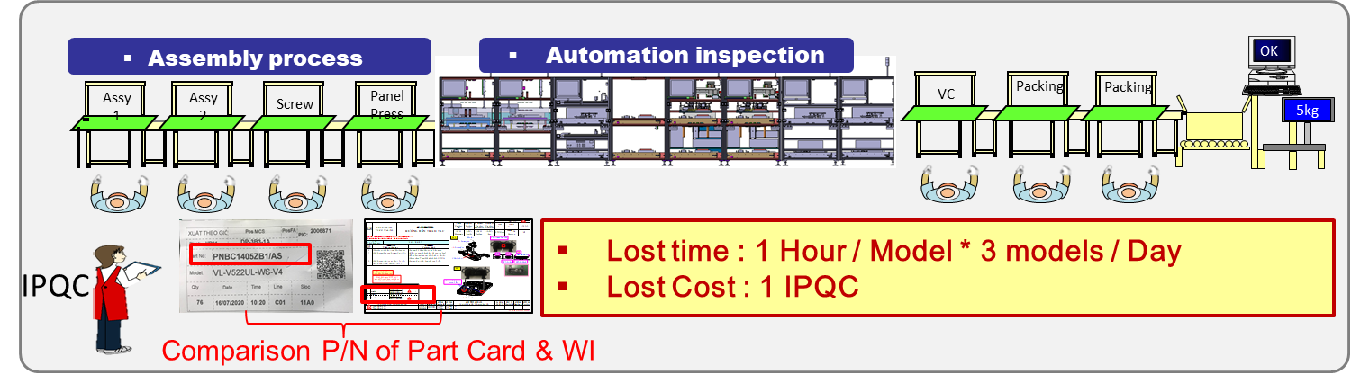
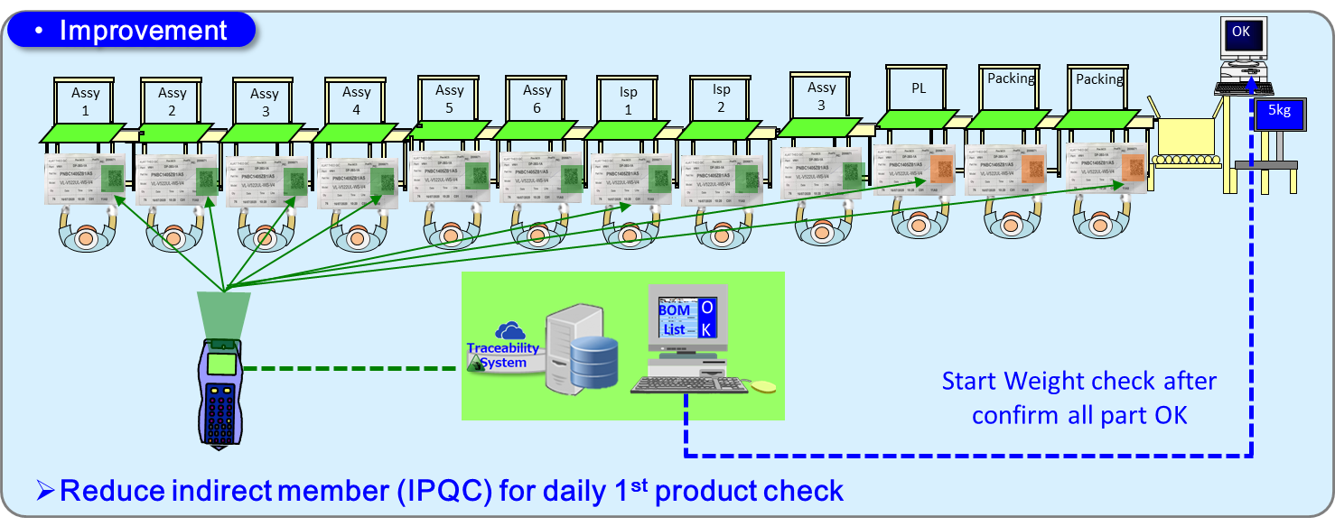
Activity 1 – Add Verify Part No by Read Barcode
MW
【 Current Situation 】
Daily 100% manual read & check Part No (Lost time : 1 hour / model + Lost Cost :1 IPQC )
【 Requirmenet 】
Check part No by read QR Code of Part Card => Auto compare P/N with BOM list
Current Issued

Slide 2
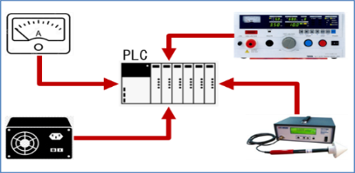
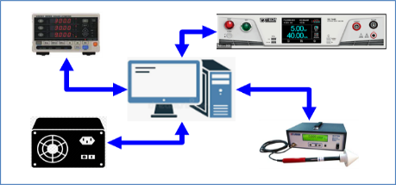
Activity 2 : Add link Log file S/N to Weight checker
MW
【 Current Situation 】
OCS Line : Using PLC System – Have no log file of inspection checker => Can’t link Weight checker
【 Requirmenet 】
OCS Line : Change PC System => Request add link check Log file S/N to Weight checker.
Before
Current：OCS Line : Using PLC System – Have no log file of inspection checker => Can’t link Weight checker Weak point : Easy skip process
After
Improvement：OCS Line : Change PC System => Request add link check Log file S/N to Weight checker. Benefit : Prevent Skip process (Ensure Quality)
OK
OK
OK
OK
OK
OK
Panel
Press
OK
Panel
Press
Packing
OK
Screw
Screw
Packing
Packing
Screw
Screw
Packing
5kg
5kg
Can’t link Log S/N to Weight checker
Link Log S/N to Weight checker
Using checker Import from KABD control by PLC
Change checker make by PSNV-PE control by PC

Slide 3
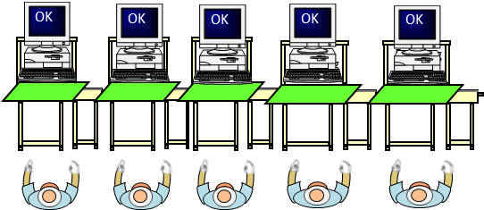
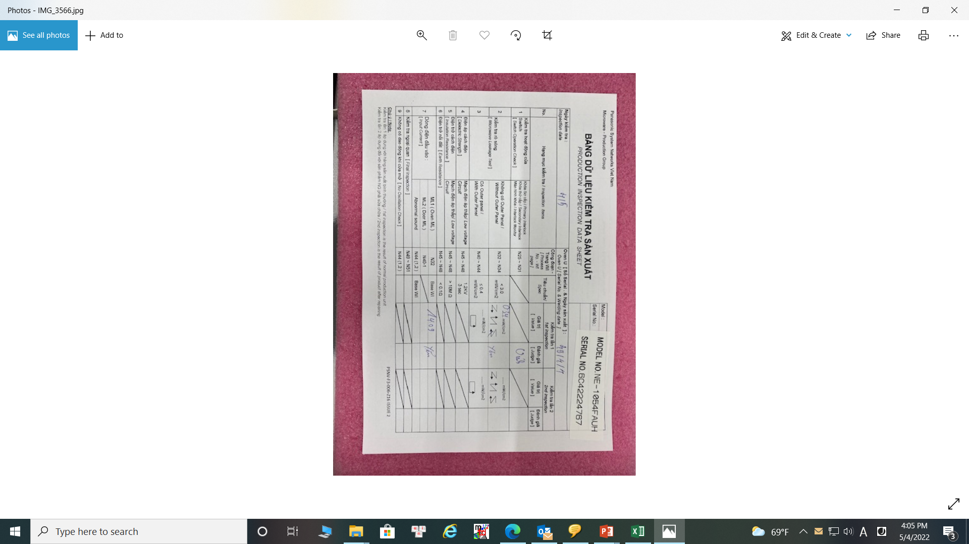




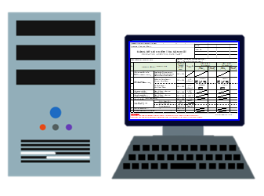


Activity 3: Creat inspection check sheet from Log file
MW
【 Current Situation 】
Daily production must print hard check sheet , manual record and lost time to input inspection data.
【 Requirmenet 】
Extract inspection data from log file , automatically switch to soft check sheet
Before
Current：Daily print hard check sheet & manual write down => then 1 member must input data => Storage hard copy Weak point : Lost time – 34,560 minutes / Year Paper cost : 864$/Year + Labor cost : 1pax ~ 7,200$/Year
After
Improvement：Link inspection data from checker’s log file to Check sheet : Model , S/N , Operator ID , Inspection result. Benefit : Reduce lost time 34,560 minutes / Year Reduce Paper cost + Labor cost : 8,064$/Year
Log File
Each process write down
Inspection result
Creat inspection data to check sheet from Log file
Print hard copy check sheet : 500pcs / Day
Manual input data to PC
Storage hard copy
Save in Sever

Slide 4
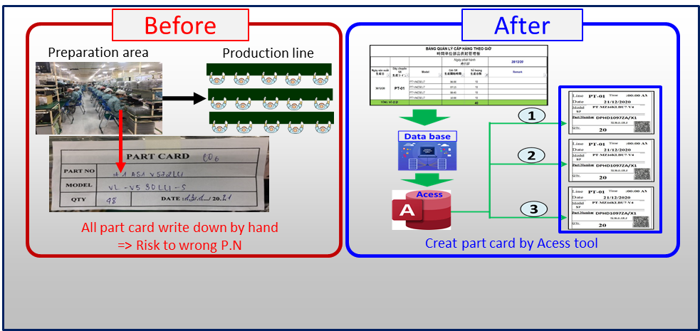
Activity 4 : Auto creat part card for preparation area
All
【 Current Situation 】
Print Label & Prepararion Area : Must Manual write down Part Card when transfer material to FA Line
【 Requirmenet 】
Use techinal tool for auto creat Part card (Include QR Code)
Before
Current：Print Label & Prepararion Area : Must Manual write down Part Card when transfer material to FA Line Weak point : Risk of operation mistake & Lost time (200 parts ~ 100 minutes /day ~ 480hours/Year )
After
Improvement：Use a technical tool to creat part card , include QR Code. Benefit : Prevent operation mistake Reduce lost time : 480hours / Year

